Slide 1
Module 2
What Is a Chip?

Slide 2
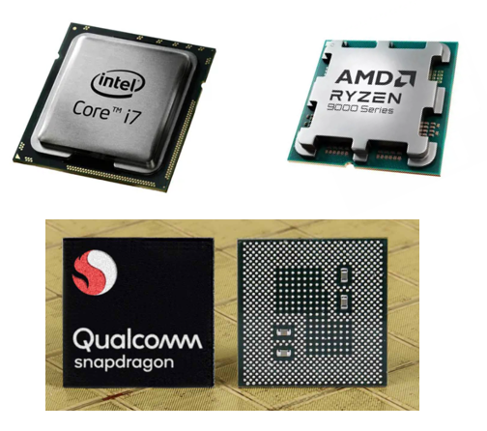
Intro
What is a “Chip”?
Tiny pieces of technology that:
Take in info
Make simple decisions
Control how devices behave
Why do you already use hundreds every day
They are the hidden “brains” inside things

Slide 3
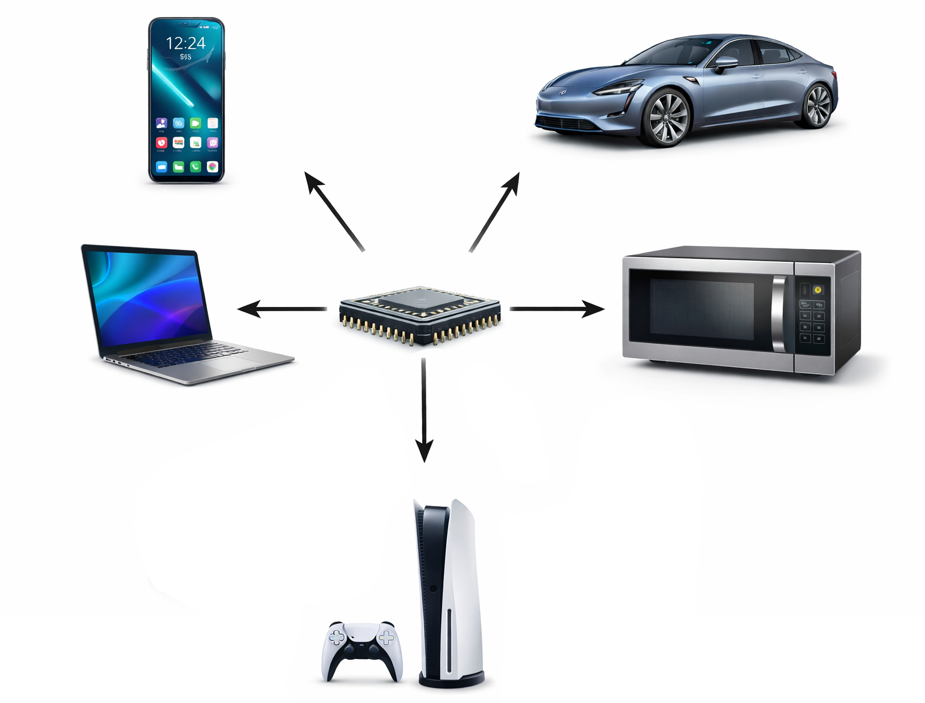
Inside Everyday Devices
Devices:
Smart Phone
Laptop
Car
Microwave
Game console
etc.
Key Idea:
Chips are everywhere, even where you don’t expect them

Slide 4
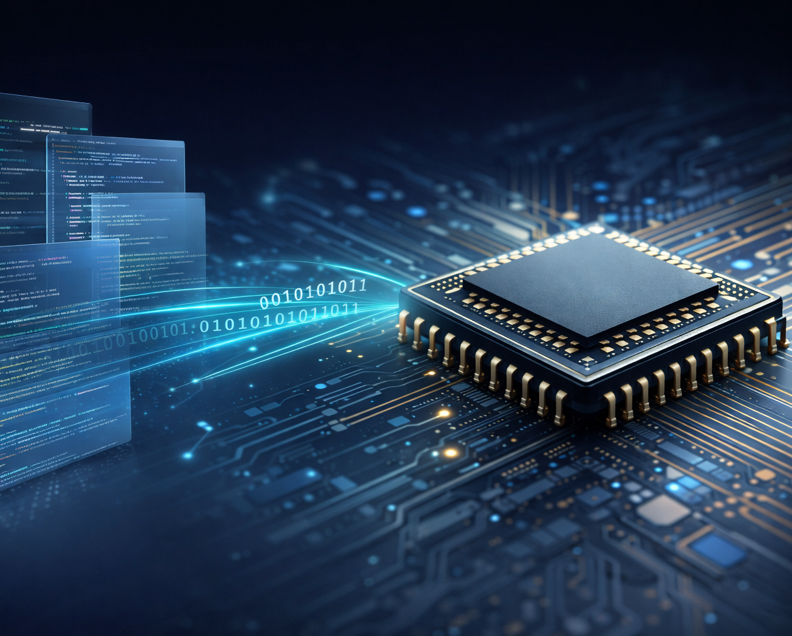
Chip vs. Software
Software = instructions
Chip = a machine that follows instructions
Software needs chips to exist

Slide 5
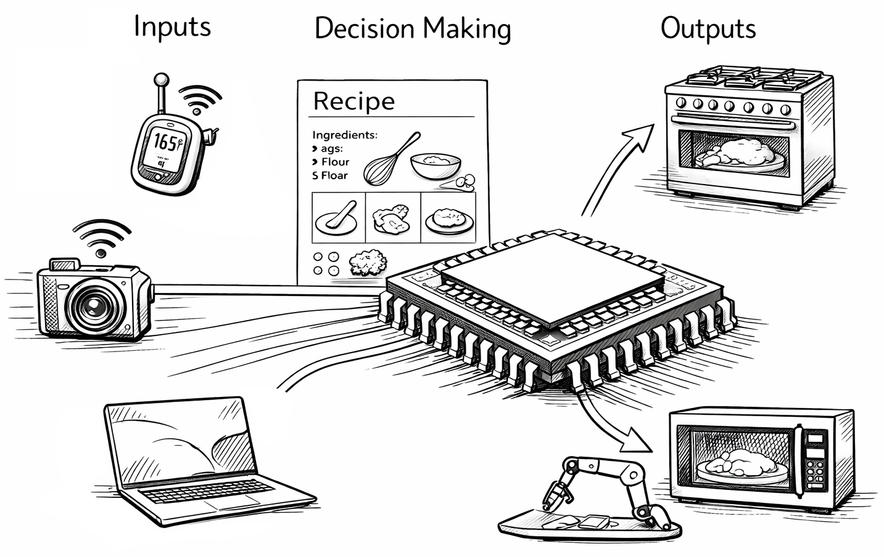
What a Chip Actually Does
Analogy: Recipe + Kitchen Appliances

Slide 6
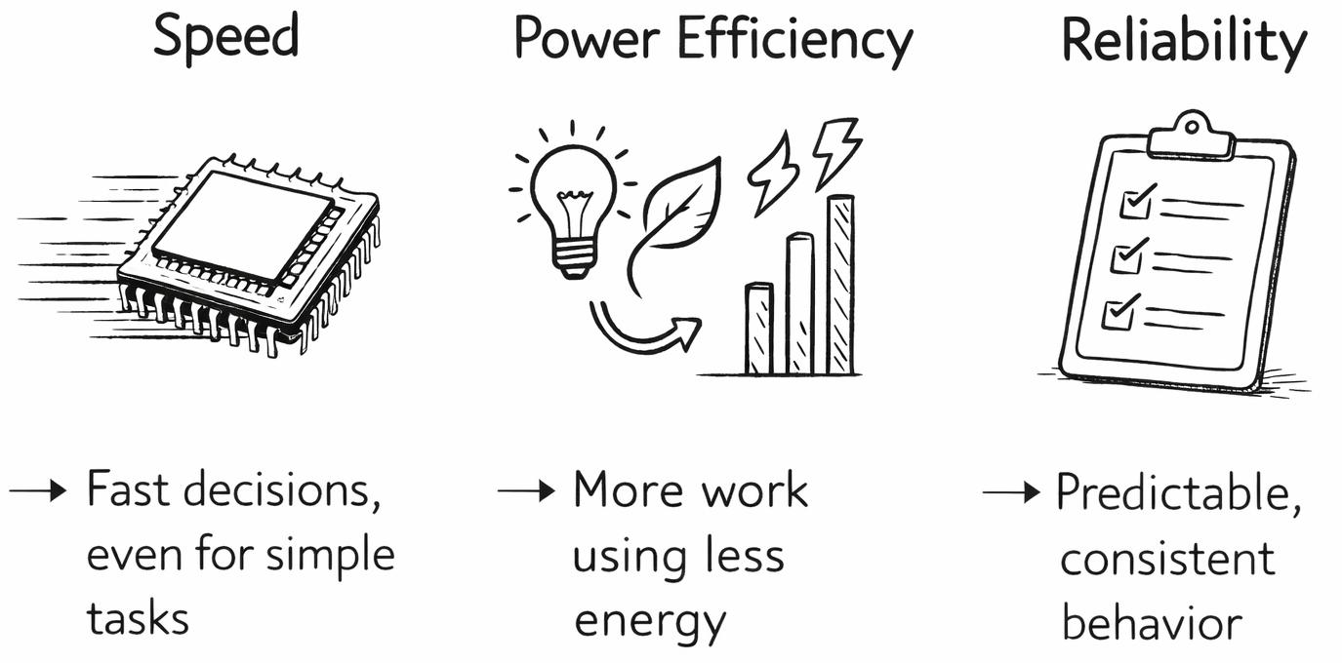
Why Chips Exist

Slide 7
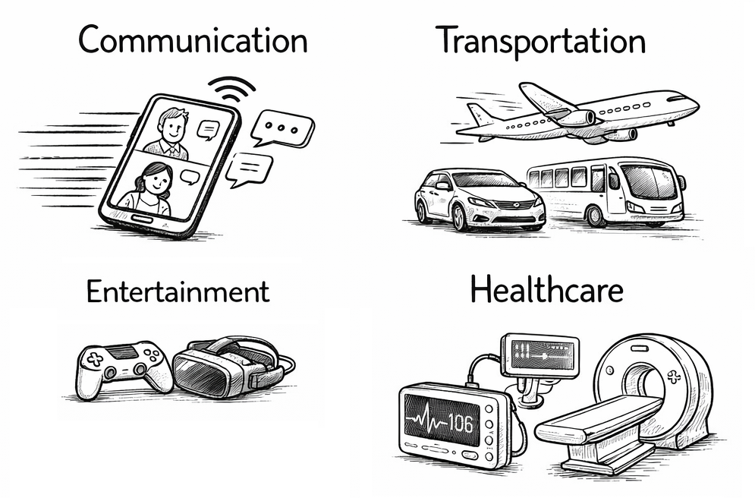
Chips and Society
Communication
Chips make it possible to send messages, make video calls, and use the internet
Every text, call, and video depends on chips working together behind the scenes
Transportation
Cars, buses, planes, and trains use chips to control engines, brakes, navigation, and safety systems
Modern transportation would not work reliably without chips
Healthcare
Medical devices like heart monitors, imaging machines, and insulin pumps rely on chips to operate safely and accurately
Chips help doctors diagnose and treat patients
Entertainment
Video games, streaming services, music, and virtual reality all depend on chips to process graphics, sound, and user input in real time
Chips turn ideas into interactive experiences

Slide 8
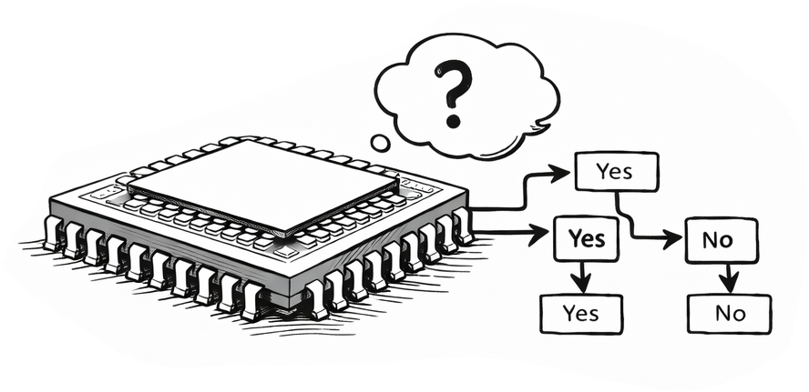
Chips Don’t Think
Computer chips do not think, feel, or understand
They follow very specific rules given to them
Each rule is a simple Yes/No decision
Big Idea
A chip is like a very fast rule-follower, not a human brain

Slide 9
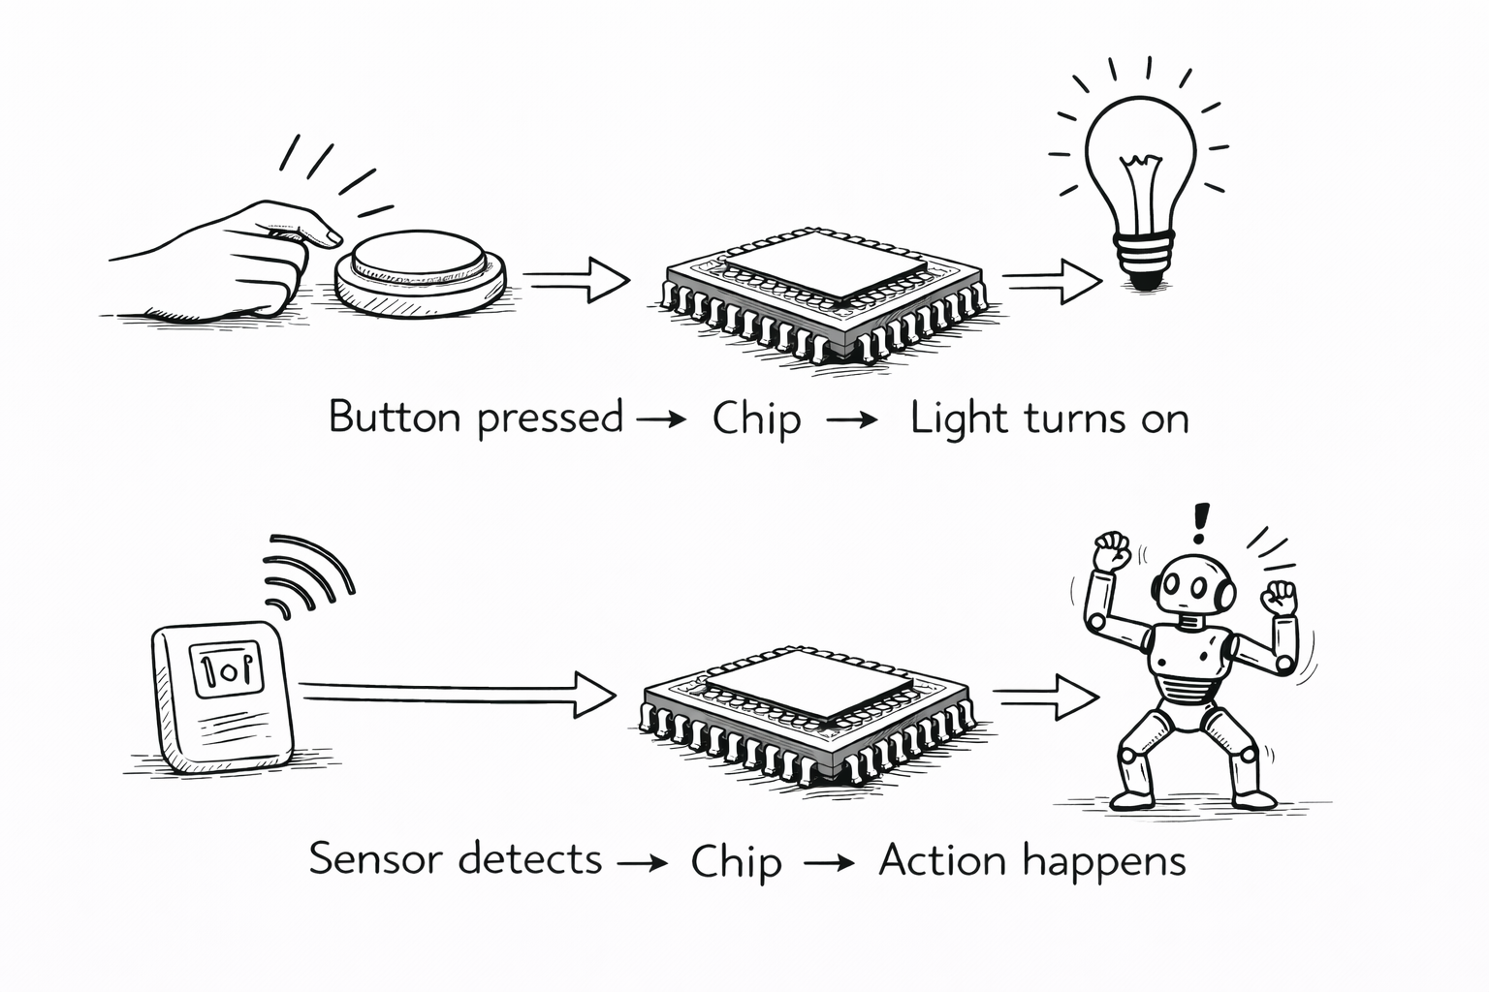
Inputs and Outputs (I/O)
Chips connect the outside world to actions
Input
Something that goes into a chip
Examples:
Button pressed
Temperature sensed
Camera sees light
Output
Something that comes out of a chip
Examples:
Light turns on
Motor moves
Sound plays
Simple Idea
A chip looks at inputs and decides what outputs to produce

Slide 10
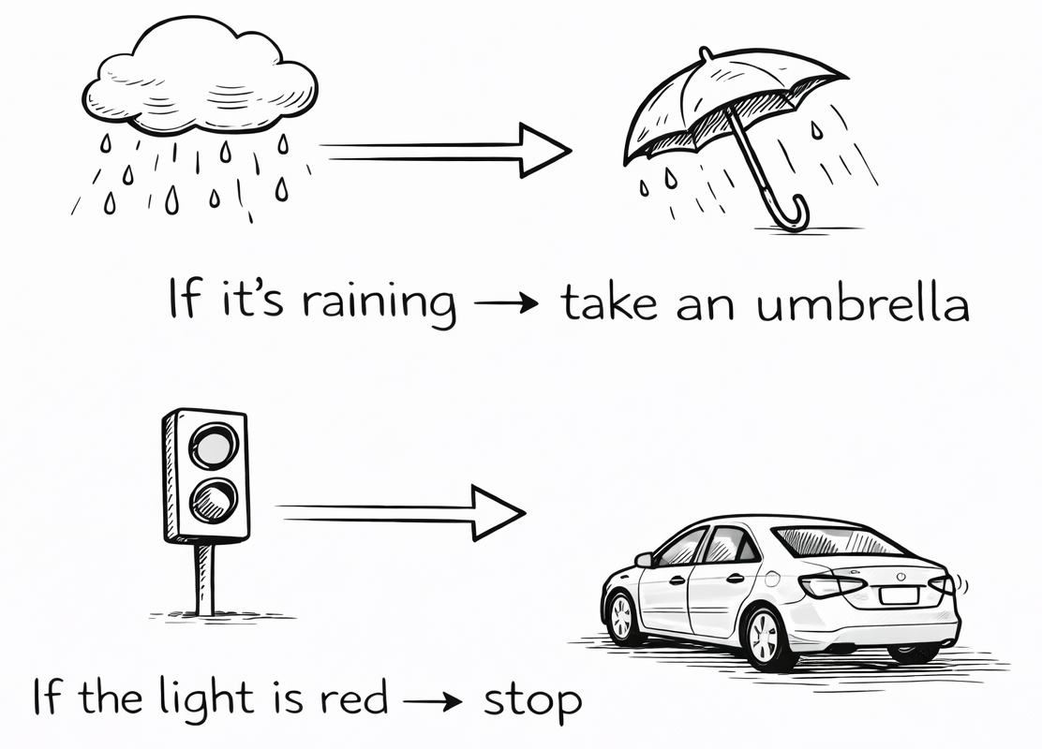
Decision Rules
Chips follow simple rules
“If this, then that”
If a button is pressed → turn on the light
If it’s too hot → turn on the fan
If a message arrives → show a notification
Everyday examples
If it’s raining → take an umbrella
If the light is red → stop
If your alarm goes off → wake up
Big idea
A chip doesn’t guess or think - it follows rules exactly

